Slide 1
Do Now
Name these compounds: 1. PbCl₂
2. Na₂S
3. S₂Cl₂
4. N₂O₄
5. MgF₂
For an extra challenge:
6. Cl₂O₇
Lead chloride
Sodium sulfide
Disulfur dichloride
Dinitrogen tetraoxide
Magnesium fluoride
Dichloride heptoxide

Slide 2
Daily Review
There are different rules for naming different types of compounds.
Naming Compounds [metal – non-metal]
Write the name of the metal first
Write the name of the non-metal second and change the ending to –ide
CFU 1
Which element’s name gets changed, and how?
CFU 2
What order are the names written in?
Chemical formula: KBr
Write the name of the metal first
Potassium
Write the name of the non-metal second
Potassium bromine
Change the ending of the non-metal to -ide
Potassium bromide
Hint:
The numbers in a compound formula are NOT written in the name.

Slide 3
Daily Review
There are different rules for naming different types of compounds.
Naming Compounds [non-metal – non-metal]
Write the elements in the order they appear in the formula
A prefix is put in front of each element to show how many there are
If there is only one atom of the first element, no prefix is needed
The ending of the last element is changed to –ide
CFU 1
When don’t you need a prefix?
CFU 3
Which element’s name gets changed, and how?
Chemical formula: PH₃
Write the elements in order
Phosphorus hydrogen
Add prefixes to show how many atoms of each there are
Phosphorus trihydrogen
Change the ending of the last element to -ide
Phosphorus trihydride
Hint:
One: mono Two: di Three: tri Four: tetra

Slide 4
Daily Review
There are different rules for naming different types of compounds.
Naming Compounds [metal – non-metal]
Write the name of the metal first
Write the name of the non-metal second and change the ending to –ide
Naming Compounds [non-metal – non-metal]
Write the elements in the order they appear in the formula
A prefix is put in front of each element to show how many there are
If there is only one atom of the first element, no prefix is needed
The ending of the last element is changed to –ide
Hint:
One: mono Two: di Three: tri Four: tetra
Use the rules above to name the following compounds:
PCℓ₃
Na₂O
BaF₂
N₂Cℓ₄
PbBr₂

Slide 5
Daily Review
There are different rules for naming different types of compounds.
Naming Compounds [metal – non-metal]
Write the name of the metal first
Write the name of the non-metal second and change the ending to –ide
Naming Compounds [non-metal – non-metal]
Write the elements in the order they appear in the formula
A prefix is put in front of each element to show how many atoms of each there are
The ending of the last element is changed to –ide
If there is only one atom of the first element, no prefix is needed
Hint:
One: mono Two: di Three: tri Four: tetra
Use the rules above to determine the formulae of the following compounds:
Nitrogen dioxide
Disulfur difluoride
Iodine trichloride
Tetraphosphorus decoxide (Hint: how many years are there in a decade?)

Slide 6
Physical and Chemical Changes Year 8 Science

Slide 7
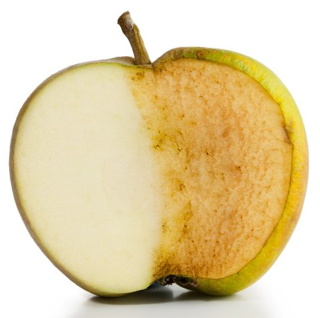
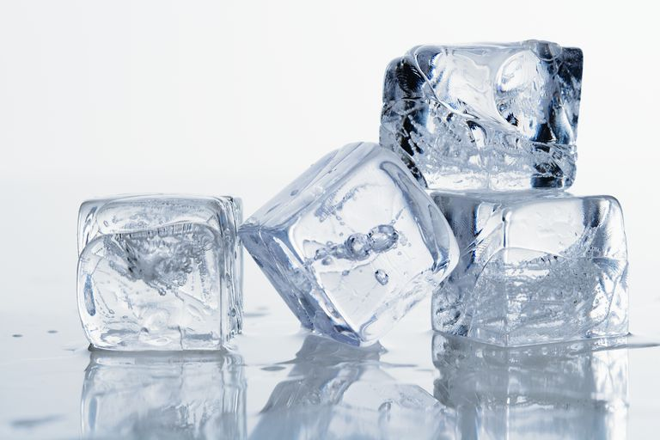
Learning Objectives
CFU
What two types of changes are we learning about?
Define physical change and chemical change.
Identify a change in a substance as chemical or physical.
Activate Prior Knowledge
Half an apple has been left out on a bench and has turned brown. On the same bench, an handful of ice blocks is melting.
On your whiteboard, write down two similarities and two differences between these changes.

Slide 8

Concept Development
CFU 1
How can you tell that a change is a physical change?
Substances can go through physical changes and chemical changes.
Physical change:
a substance might look different, but its particles (atoms / molecules) have not changed.
usually reversible
Examples of physical changes include:
Phase changes (melting, freezing, boiling, condensing, etc.) – ice, water and steam are all H₂O
Changes to an object’s shape – the same particles are arranged differently
CFU 2
Which of these changes are physical changes? Be ready to explain your answers. Using paper for origami Baking a cake Hammering a nail into wood Burning wood on a bonfire Baking soda and vinegar reacting in a model volcano Cutting your hair Boiling water in a kettle

Slide 9
Concept Development
CFU 1
How can you tell that a change is a chemical change?
Substances can go through physical changes and chemical changes.
Chemical change:
A new substance has been formed with different particles.
Changes are usually not reversible.
Chemical changes might produce:
A gas e.g. limestone ‘fizzing’ in acid)
A permanent change in colour (e.g. rust)
Light or heat (e.g. an explosion)
A solid called a precipitate
CFU 2
What is the difference between a chemical change and a physical change?
Vocabulary
physical change a change in shape or state that does not alter a substance’s particles

Slide 10
Skill Development / Guided Practice
CFU 1
What happens to a substance’s particles during a physical change?
Physical Changes | Chemical Changes
Same substance remains: particles (atoms / molecules) unaffected Usually reversible Examples: change of shape, change of state | New substance forms: particles are new and different Usually irreversible Examples: gas, light or heat produced; permanent colour change; precipitate formed
CFU 2
What happens to a substance’s particles during a chemical change?
CFU 3
How can you tell that a physical change has occurred?
CFU 4
How can you tell that a chemical change has occurred?
Classifying a change is as easy as deciding which column it matches more closely.
Vocabulary
precipitate (noun) an insoluble solid formed from two solutions

Slide 11
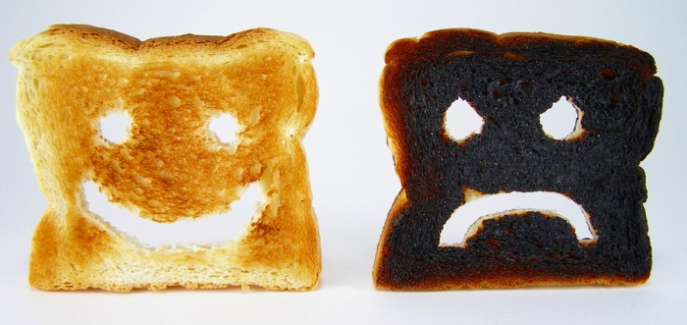
Skill Development / Guided Practice
CFU 1
Have the particles changed? How can you tell?
Physical Changes | Chemical Changes
Same substance remains: particles (atoms / molecules) unaffected Usually reversible Examples: change of shape, change of state | New substance forms: particles are new and different Usually irreversible Examples: gas, light or heat produced; permanent colour change; precipitate formed
CFU 2
Is the change reversible?
CFU 3
Does this change match the description of a physical change or a chemical change?
Is making (or burning) toast a physical or chemical change?
This is a chemical change, because the colour of the substance has changed irreversibly. There are new particles with a new colour.
Vocabulary
precipitate (noun) an insoluble solid formed from two solutions

Slide 12

Skill Development / Guided Practice
CFU 1
Have the particles changed? How can you tell?
Physical Changes | Chemical Changes
Same substance remains: particles (atoms / molecules) unaffected Usually reversible Examples: change of shape, change of state | New substance forms: particles are new and different Usually irreversible Examples: gas, light or heat produced; permanent colour change; precipitate formed
CFU 2
Is the change reversible?
CFU 3
Does this change match the description of a physical change or a chemical change?
Is rain caused by a physical or chemical change?
This is a physical change, because the water particles are unaffected and the change is reversible.
Vocabulary
precipitate (noun) an insoluble solid formed from two solutions

Slide 13
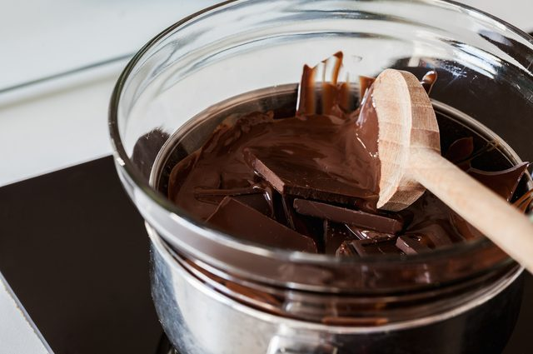
Skill Development / Guided Practice
CFU 1
Have the particles changed? How can you tell?
Physical Changes | Chemical Changes
Same substance remains: particles (atoms / molecules) unaffected Usually reversible Examples: change of shape, change of state | New substance forms: particles are new and different Usually irreversible Examples: gas, light or heat produced; permanent colour change; precipitate formed
CFU 2
Is the change reversible?
CFU 3
Does this change match the description of a physical change or a chemical change?
Is melting chocolate a physical or chemical change?
This is a physical change, because the chocolate particles are unaffected and the change is reversible.
CFU 3
Would burning the chocolate be a physical change? Why or why not?
Vocabulary
precipitate (noun) an insoluble solid formed from two solutions

Slide 14
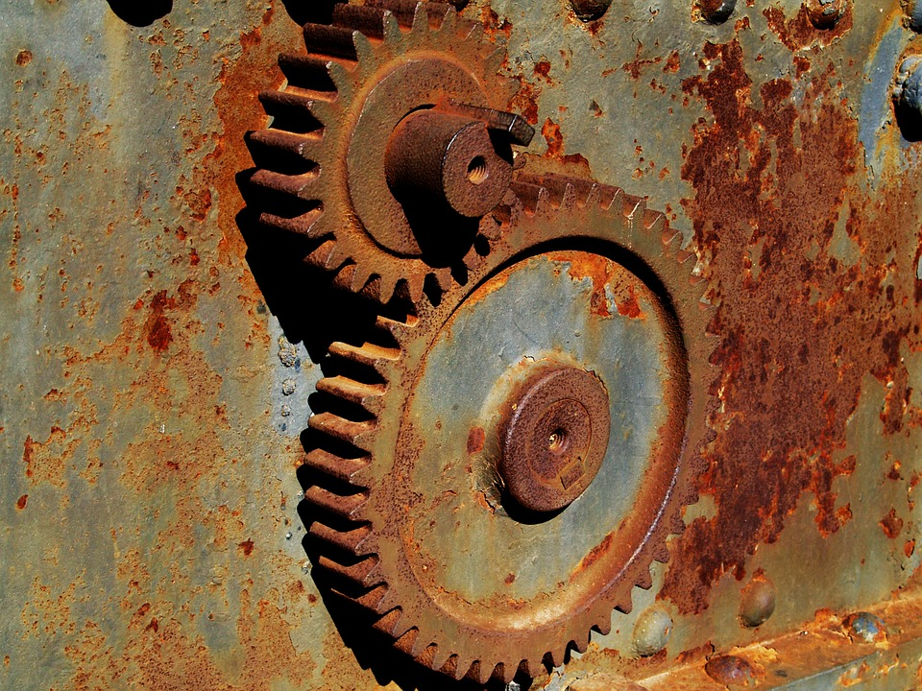
Skill Development / Guided Practice
CFU 1
Have the particles changed? How can you tell?
Physical Changes | Chemical Changes
Same substance remains: particles (atoms / molecules) unaffected Usually reversible Examples: change of shape, change of state | New substance forms: particles are new and different Usually irreversible Examples: gas, light or heat produced; permanent colour change; precipitate formed
CFU 2
Is the change reversible?
CFU 3
Does this change match the description of a physical change or a chemical change?
Is rust caused by a physical or chemical change?
This is a chemical change, because the colour of the substance has changed irreversibly. There are new particles with a new colour.
Vocabulary
precipitate (noun) an insoluble solid formed from two solutions

Slide 15
https://youtu.be/PK8dsAeMmPk?t=159

Slide 16
https://youtu.be/JOHdZsQXw7I

Slide 17
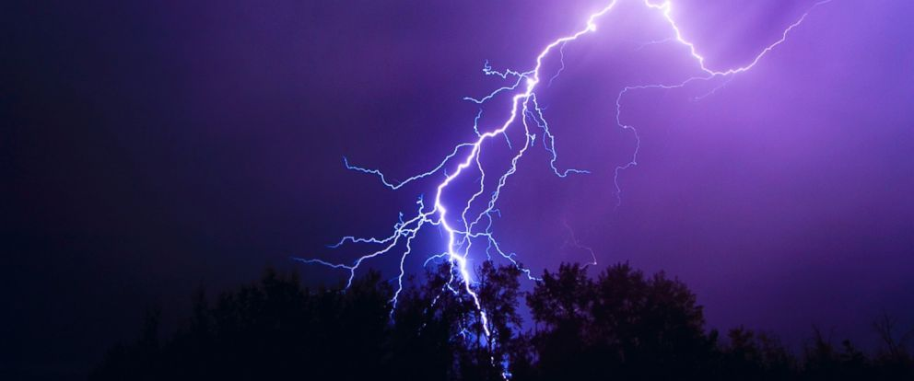
Relevance
Physical and chemical changes are all around you: they happen when you cook, in the weather, in cars and bikes, and inside your body right now!
Predicting physical and chemical changes is important when storing food, and even more so when storing dangerous chemicals.
Lightning splits nitrogen molecules in the air (a chemical change) allowing it to be used by plants. The accompanying thunder is caused by the heat rapidly expanding the air (a physical change).

Slide 18
Skill Closure
Physical Changes | Chemical Changes
Same substance remains: particles (atoms / molecules) unaffected Usually reversible Examples: change of shape, change of state | New substance forms: particles are new and different Usually irreversible Examples: gas, light or heat produced; permanent colour change; precipitate formed
Name two differences between physical and chemical changes.
Skill Closure
Is dissolving salt in water a physical or a chemical change? Explain your answer.
Skill Closure
In water treatment plants, a solution of sodium hydroxide is added to waste water. This reacts with poisonous metals (such as lead and mercury) to form an insoluble solid which can then be filtered out. Is this a physical change or a chemical change?
Vocabulary
precipitate (noun) an insoluble solid formed from two solutions

Slide 19
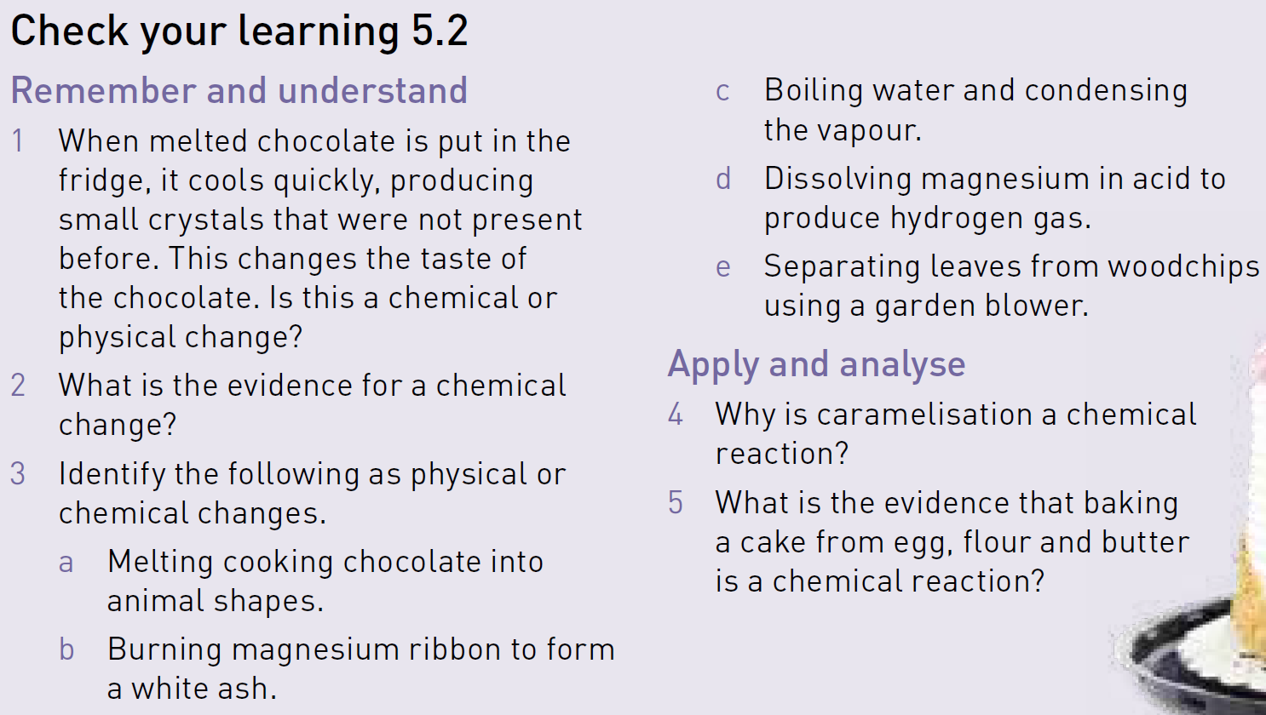
Independent Practice
Physical Changes
Same substance remains: particles (atoms / molecules) unaffected Usually reversible Examples: change of shape, change of state
Chemical Changes
New substance forms: particles are new and different Usually irreversible Examples: gas, light or heat produced; permanent colour change; precipitate formed
Attempt Questions 1-5 on page 83 of your textbook.

